Slide 1
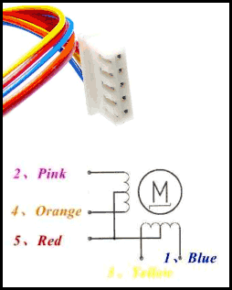
Stepper Motor Interface

Slide 2
Inside the motor there are two center tapped coils available. Red wire is the common for both which will be connected at VCC or 5V.
Other 4 wires pink, Orange, yellow and blue will control the rotation depending on the electrical signal. Also, depending on the movement, this motor can be controlled using 3 steps. Full drive mode, Half Drive mode and Wave drive mode.

Slide 3
Three Driving Modes of Stepper Motor:
Full Drive: If two stator electromagnets are energized at a time, the motor will run at full torque referred as full-drive sequence mode.
Half-Drive: When alternatively one and two phases are energized, the motor will run in half drive mode. It’s used to increase the angular resolution. Drawback is less torque produced in this movement.
Wave Drive: In this mode, one stator electromagnet is turned on. Its follows 4 steps same as Full-drive mode. It consumes low power with low torque.

Slide 4
Full Drive Mode data
Step | Blue | Pink | Yellow | Orange
1 | 1 | 1 | 0 | 0
2 | 0 | 1 | 1 | 0
3 | 0 | 0 | 1 | 1
4 | 1 | 0 | 0 | 1

Slide 5
Half Drive Mode data
Step | Blue | Pink | Yellow | Orange
1 | 1 | 0 | 0 | 0
2 | 1 | 1 | 0 | 0
3 | 0 | 1 | 0 | 0
4 | 0 | 1 | 1 | 0
5 | 0 | 0 | 1 | 1
6 | 0 | 0 | 0 | 1
7 | 1 | 0 | 0 | 1
8 | 1 | 0 | 0 | 0

Slide 6
Wave Drive Mode data
Step | Blue | Pink | Yellow | Orange
1 | 1 | 0 | 0 | 0
2 | 0 | 1 | 0 | 0
3 | 0 | 0 | 1 | 0
4 | 0 | 0 | 0 | 1

Slide 7
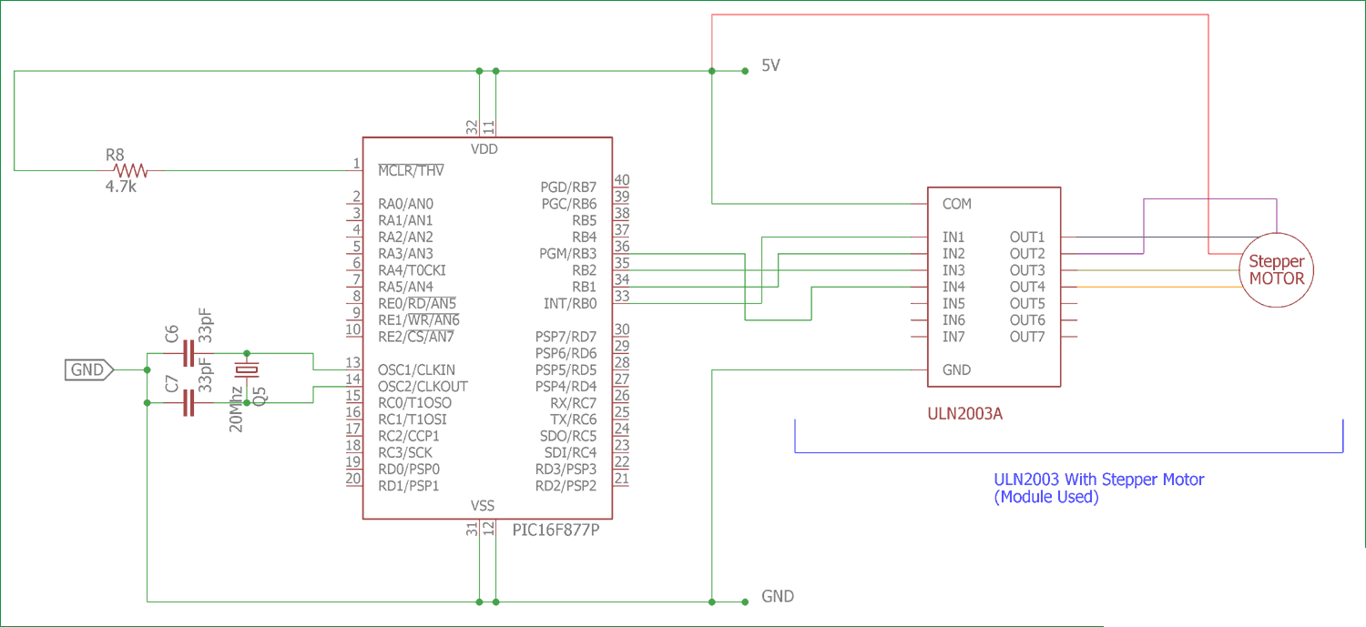

Slide 8
void main()
{
TRISD = 0b0000000; // PORT D as output port
PORTD = 0b1111111;
do
{
PORTD = 0b00000011; // energizing two phases at a time
Delay_ms(500); // delay of 0.5s
PORTD = 0b00000110;
Delay_ms(500);
PORTD = 0b00001100;
Delay_ms(500);
PORTD = 0b00001001;
Delay_ms(500);
}while(1); // loop executed infinite times
}

